Slide 1
Finding Regulatory Motifs in DNA Sequences

Slide 2
Outline
Implanting Patterns in Random Text
Gene Regulation
Regulatory Motifs
The Gold Bug Problem
The Motif Finding Problem
Brute Force Motif Finding
The Median String Problem
Search Trees
Branch-and-Bound Motif Search
Branch-and-Bound Median String Search
Consensus and Pattern Branching: Greedy Motif Search
PMS: Exhaustive Motif Search

Slide 3
Random Sample
atgaccgggatactgataccgtatttggcctaggcgtacacattagataaacgtatgaagtacgttagactcggcgccgccg
acccctattttttgagcagatttagtgacctggaaaaaaaatttgagtacaaaacttttccgaatactgggcataaggtaca
tgagtatccctgggatgacttttgggaacactatagtgctctcccgatttttgaatatgtaggatcattcgccagggtccga
gctgagaattggatgaccttgtaagtgttttccacgcaatcgcgaaccaacgcggacccaaaggcaagaccgataaaggaga
tcccttttgcggtaatgtgccgggaggctggttacgtagggaagccctaacggacttaatggcccacttagtccacttatag
gtcaatcatgttcttgtgaatggatttttaactgagggcatagaccgcttggcgcacccaaattcagtgtgggcgagcgcaa
cggttttggcccttgttagaggcccccgtactgatggaaactttcaattatgagagagctaatctatcgcgtgcgtgttcat
aacttgagttggtttcgaaaatgctctggggcacatacaagaggagtcttccttatcagttaatgctgtatgacactatgta
ttggcccattggctaaaagcccaacttgacaaatggaagatagaatccttgcatttcaacgtatgccgaaccgaaagggaag
ctggtgagcaacgacagattcttacgtgcattagctcgcttccggggatctaatagcacgaagcttctgggtactgatagca

Slide 4
Implanting Motif AAAAAAAGGGGGGG
atgaccgggatactgatAAAAAAAAGGGGGGGggcgtacacattagataaacgtatgaagtacgttagactcggcgccgccg
acccctattttttgagcagatttagtgacctggaaaaaaaatttgagtacaaaacttttccgaataAAAAAAAAGGGGGGGa
tgagtatccctgggatgacttAAAAAAAAGGGGGGGtgctctcccgatttttgaatatgtaggatcattcgccagggtccga
gctgagaattggatgAAAAAAAAGGGGGGGtccacgcaatcgcgaaccaacgcggacccaaaggcaagaccgataaaggaga
tcccttttgcggtaatgtgccgggaggctggttacgtagggaagccctaacggacttaatAAAAAAAAGGGGGGGcttatag
gtcaatcatgttcttgtgaatggatttAAAAAAAAGGGGGGGgaccgcttggcgcacccaaattcagtgtgggcgagcgcaa
cggttttggcccttgttagaggcccccgtAAAAAAAAGGGGGGGcaattatgagagagctaatctatcgcgtgcgtgttcat
aacttgagttAAAAAAAAGGGGGGGctggggcacatacaagaggagtcttccttatcagttaatgctgtatgacactatgta
ttggcccattggctaaaagcccaacttgacaaatggaagatagaatccttgcatAAAAAAAAGGGGGGGaccgaaagggaag
ctggtgagcaacgacagattcttacgtgcattagctcgcttccggggatctaatagcacgaagcttAAAAAAAAGGGGGGGa

Slide 5
Where is the Implanted Motif?
atgaccgggatactgataaaaaaaagggggggggcgtacacattagataaacgtatgaagtacgttagactcggcgccgccg
acccctattttttgagcagatttagtgacctggaaaaaaaatttgagtacaaaacttttccgaataaaaaaaaaggggggga
tgagtatccctgggatgacttaaaaaaaagggggggtgctctcccgatttttgaatatgtaggatcattcgccagggtccga
gctgagaattggatgaaaaaaaagggggggtccacgcaatcgcgaaccaacgcggacccaaaggcaagaccgataaaggaga
tcccttttgcggtaatgtgccgggaggctggttacgtagggaagccctaacggacttaataaaaaaaagggggggcttatag
gtcaatcatgttcttgtgaatggatttaaaaaaaaggggggggaccgcttggcgcacccaaattcagtgtgggcgagcgcaa
cggttttggcccttgttagaggcccccgtaaaaaaaagggggggcaattatgagagagctaatctatcgcgtgcgtgttcat
aacttgagttaaaaaaaagggggggctggggcacatacaagaggagtcttccttatcagttaatgctgtatgacactatgta
ttggcccattggctaaaagcccaacttgacaaatggaagatagaatccttgcataaaaaaaagggggggaccgaaagggaag
ctggtgagcaacgacagattcttacgtgcattagctcgcttccggggatctaatagcacgaagcttaaaaaaaaggggggga

Slide 6
Implanting Motif AAAAAAGGGGGGG with Four Mutations
atgaccgggatactgatAgAAgAAAGGttGGGggcgtacacattagataaacgtatgaagtacgttagactcggcgccgccg
acccctattttttgagcagatttagtgacctggaaaaaaaatttgagtacaaaacttttccgaatacAAtAAAAcGGcGGGa
tgagtatccctgggatgacttAAAAtAAtGGaGtGGtgctctcccgatttttgaatatgtaggatcattcgccagggtccga
gctgagaattggatgcAAAAAAAGGGattGtccacgcaatcgcgaaccaacgcggacccaaaggcaagaccgataaaggaga
tcccttttgcggtaatgtgccgggaggctggttacgtagggaagccctaacggacttaatAtAAtAAAGGaaGGGcttatag
gtcaatcatgttcttgtgaatggatttAAcAAtAAGGGctGGgaccgcttggcgcacccaaattcagtgtgggcgagcgcaa
cggttttggcccttgttagaggcccccgtAtAAAcAAGGaGGGccaattatgagagagctaatctatcgcgtgcgtgttcat
aacttgagttAAAAAAtAGGGaGccctggggcacatacaagaggagtcttccttatcagttaatgctgtatgacactatgta
ttggcccattggctaaaagcccaacttgacaaatggaagatagaatccttgcatActAAAAAGGaGcGGaccgaaagggaag
ctggtgagcaacgacagattcttacgtgcattagctcgcttccggggatctaatagcacgaagcttActAAAAAGGaGcGGa

Slide 7
Where is the Motif???
atgaccgggatactgatagaagaaaggttgggggcgtacacattagataaacgtatgaagtacgttagactcggcgccgccg
acccctattttttgagcagatttagtgacctggaaaaaaaatttgagtacaaaacttttccgaatacaataaaacggcggga
tgagtatccctgggatgacttaaaataatggagtggtgctctcccgatttttgaatatgtaggatcattcgccagggtccga
gctgagaattggatgcaaaaaaagggattgtccacgcaatcgcgaaccaacgcggacccaaaggcaagaccgataaaggaga
tcccttttgcggtaatgtgccgggaggctggttacgtagggaagccctaacggacttaatataataaaggaagggcttatag
gtcaatcatgttcttgtgaatggatttaacaataagggctgggaccgcttggcgcacccaaattcagtgtgggcgagcgcaa
cggttttggcccttgttagaggcccccgtataaacaaggagggccaattatgagagagctaatctatcgcgtgcgtgttcat
aacttgagttaaaaaatagggagccctggggcacatacaagaggagtcttccttatcagttaatgctgtatgacactatgta
ttggcccattggctaaaagcccaacttgacaaatggaagatagaatccttgcatactaaaaaggagcggaccgaaagggaag
ctggtgagcaacgacagattcttacgtgcattagctcgcttccggggatctaatagcacgaagcttactaaaaaggagcgga

Slide 8
Why Finding (15,4) Motif is Difficult?
atgaccgggatactgatAgAAgAAAGGttGGGggcgtacacattagataaacgtatgaagtacgttagactcggcgccgccg
acccctattttttgagcagatttagtgacctggaaaaaaaatttgagtacaaaacttttccgaatacAAtAAAAcGGcGGGa
tgagtatccctgggatgacttAAAAtAAtGGaGtGGtgctctcccgatttttgaatatgtaggatcattcgccagggtccga
gctgagaattggatgcAAAAAAAGGGattGtccacgcaatcgcgaaccaacgcggacccaaaggcaagaccgataaaggaga
tcccttttgcggtaatgtgccgggaggctggttacgtagggaagccctaacggacttaatAtAAtAAAGGaaGGGcttatag
gtcaatcatgttcttgtgaatggatttAAcAAtAAGGGctGGgaccgcttggcgcacccaaattcagtgtgggcgagcgcaa
cggttttggcccttgttagaggcccccgtAtAAAcAAGGaGGGccaattatgagagagctaatctatcgcgtgcgtgttcat
aacttgagttAAAAAAtAGGGaGccctggggcacatacaagaggagtcttccttatcagttaatgctgtatgacactatgta
ttggcccattggctaaaagcccaacttgacaaatggaagatagaatccttgcatActAAAAAGGaGcGGaccgaaagggaag
ctggtgagcaacgacagattcttacgtgcattagctcgcttccggggatctaatagcacgaagcttActAAAAAGGaGcGGa
AgAAgAAAGGttGGG
..|..|||.|..|||
cAAtAAAAcGGcGGG

Slide 9
Challenge Problem
  Find a motif in a sample of
  - 20 “random” sequences (e.g. 600 nt long)
  - each sequence containing an implanted
  pattern of length 15,
  - each pattern appearing with 4 mismatches
  as (15,4)-motif.

Slide 10
Combinatorial Gene Regulation
A microarray experiment showed that when gene X is knocked out, 20 other genes are not expressed
  How can one gene have such drastic effects?

Slide 11
Regulatory Proteins
Gene X encodes regulatory protein, a.k.a. a transcription factor (TF)
The 20 unexpressed genes rely on gene X’s TF to induce transcription
A single TF may regulate multiple genes

Slide 12
Regulatory Regions
Every gene contains a regulatory region (RR) typically stretching 100-1000 bp upstream of the transcriptional start site
Located within the RR are the Transcription Factor Binding Sites (TFBS), also known as motifs, specific for a given transcription factor
TFs influence gene expression by binding to a specific location in the respective gene’s regulatory region - TFBS

Slide 13
Transcription Factor Binding Sites
A TFBS can be located anywhere within the
Regulatory Region.
TFBS may vary slightly across different regulatory regions since non-essential bases could mutate

Slide 14
Motifs and Transcriptional Start Sites
ATCCCG
gene
TTCCGG
gene
ATCCCG
gene
ATGCCG
gene
ATGCCC
gene

Slide 15
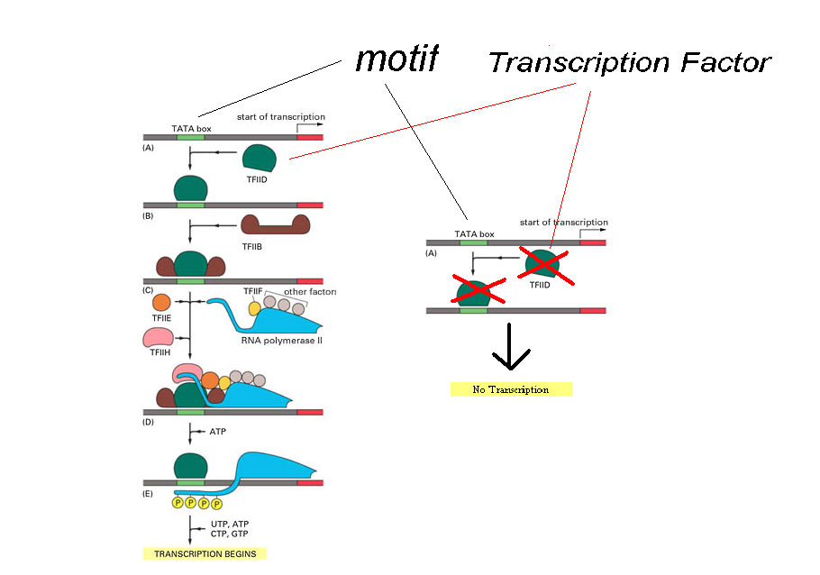
Transcription Factors and Motifs

Slide 16
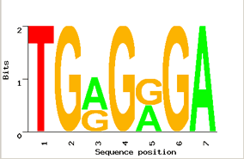
Motif Logo
TGGGGGA
TGAGAGA
TGGGGGA
TGAGAGA
TGAGGGA
Motifs can mutate on non important bases
The five motifs in five different genes have mutations in position 3 and 5
Representations called motif logos illustrate the conserved and variable regions of a motif

Slide 17
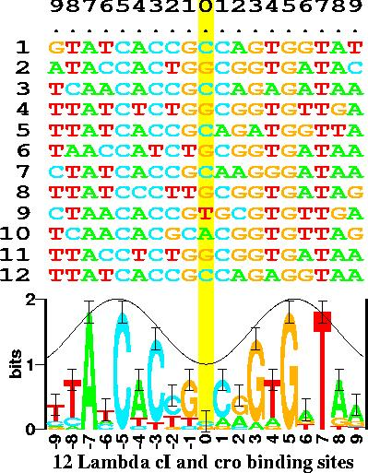
Motif Logos: An Example
(http://www-lmmb.ncifcrf.gov/~toms/sequencelogo.html)

Slide 18
Identifying Motifs
Genes are turned on or off by regulatory proteins
These proteins bind to upstream regulatory regions of genes to either attract or block an RNA polymerase
Regulatory protein (TF) binds to a short DNA sequence called a motif (TFBS)
So finding the same motif in multiple genes’ regulatory regions suggests a regulatory relationship amongst those genes

Slide 19
Identifying Motifs: Complications
We do not know the motif sequence
We do not know where it is located relative to the genes start
Motifs can differ slightly from one gene to the next
How to discern it from “random” motifs?

Slide 20



A Motif Finding Analogy
The Motif Finding Problem is similar to the problem posed by Edgar Allan Poe (1809 – 1849) in his Gold Bug story

Slide 21
The Gold Bug Problem
Given a secret message:
  53++!305))6*;4826)4+.)4+);806*;48!8`60))85;]8*:+*8!83(88)5*!;
  46(;88*96*?;8)*+(;485);5*!2:*+(;4956*2(5*-4)8`8*; 4069285);)6
  !8)4++;1(+9;48081;8:8+1;48!85;4)485!528806*81(+9;48;(88;4(+?3
  4;48)4+;161;:188;+?;
Decipher the message encrypted in the fragment

Slide 22
Hints for The Gold Bug Problem
Additional hints:
  The encrypted message is in English
  Each symbol correspond to one letter in the English alphabet
  No punctuation marks are encoded

Slide 23
The Gold Bug Problem: Symbol Counts
Naive approach to solving the problem:
  Count the frequency of each symbol in the encrypted message
  Find the frequency of each letter in the alphabet in the English language
  Compare the frequencies of the previous steps, try to find a correlation and map the symbols to a letter in the alphabet

Slide 24
Symbol Frequencies in the Gold Bug Message
Gold Bug Message:
Symbol | 8 | ; | 4 | ) | + | * | 5 | 6 | ( | ! | 1 | 0 | 2 | 9 | 3 | : | ? | ` | - | ] | .
Frequency | 34 | 25 | 19 | 16 | 15 | 14 | 12 | 11 | 9 | 8 | 7 | 6 | 5 | 5 | 4 | 4 | 3 | 2 | 1 | 1 | 1
English Language:
e t a o i n s r h l d c u m f p g w y b v k x j q z
Most frequent Least frequent

Slide 25
The Gold Bug Message Decoding: First Attempt
By simply mapping the most frequent symbols to the most frequent letters of the alphabet:
sfiilfcsoorntaeuroaikoaiotecrntaeleyrcooestvenpinelefheeosnlt
arhteenmrnwteonihtaesotsnlupnihtamsrnuhsnbaoeyentacrmuesotorl
eoaiitdhimtaecedtepeidtaelestaoaeslsueecrnedhimtaetheetahiwfa
taeoaitdrdtpdeetiwt
The result does not make sense

Slide 26
The Gold Bug Problem: l-tuple count
A better approach:
  Examine frequencies of l-tuples, combinations of 2 symbols, 3 symbols, etc.
  “The” is the most frequent 3-tuple in English and “;48” is the most frequent 3-tuple in the encrypted text
  Make inferences of unknown symbols by examining other frequent l-tuples

Slide 27
The Gold Bug Problem: the ;48 clue
Mapping “the” to “;48” and substituting all occurrences of the symbols:
53++!305))6*the26)h+.)h+)te06*the!e`60))e5t]e*:+*e!e3(ee)5*!t
h6(tee*96*?te)*+(the5)t5*!2:*+(th956*2(5*h)e`e*th0692e5)t)6!e
)h++t1(+9the0e1te:e+1the!e5th)he5!52ee06*e1(+9thet(eeth(+?3ht
he)h+t161t:1eet+?t

Slide 28
The Gold Bug Message Decoding: Second Attempt
Make inferences:
53++!305))6*the26)h+.)h+)te06*the!e`60))e5t]e*:+*e!e3(ee)5*!t
h6(tee*96*?te)*+(the5)t5*!2:*+(th956*2(5*h)e`e*th0692e5)t)6!e
)h++t1(+9the0e1te:e+1the!e5th)he5!52ee06*e1(+9thet(eeth(+?3ht
he)h+t161t:1eet+?t
“thet(ee” most likely means “the tree”
  Infer “(“ = “r”
“th(+?3h” becomes “thr+?3h”
  Can we guess “+” and “?”?

Slide 29
The Gold Bug Problem: The Solution
After figuring out all the mappings, the final message is:
AGOODGLASSINTHEBISHOPSHOSTELINTHEDEVILSSEATWENYONEDEGRE
ESANDTHIRTEENMINUTESNORTHEASTANDBYNORTHMAINBRANCHSEVENT HLIMBEASTSIDESHOOTFROMTHELEFTEYEOFTHEDEATHSHEADABEELINE
FROMTHETREETHROUGHTHESHOTFIFTYFEETOUT

Slide 30
The Solution (cont’d)
Punctuation is important:
A GOOD GLASS IN THE BISHOP’S HOSTEL IN THE DEVIL’S SEA,
TWENY ONE DEGREES AND THIRTEEN MINUTES NORTHEAST AND BY NORTH,
MAIN BRANCH SEVENTH LIMB, EAST SIDE, SHOOT FROM THE LEFT EYE OF
THE DEATH’S HEAD A BEE LINE FROM THE TREE THROUGH THE SHOT,
FIFTY FEET OUT.

Slide 31
Solving the Gold Bug Problem
Prerequisites to solve the problem:
  Need to know the relative frequencies of single letters, and combinations of two and three letters in English
  Knowledge of all the words in the English dictionary is highly desired to make accurate inferences

Slide 32
Motif Finding and The Gold Bug Problem: Similarities
  Nucleotides in motifs encode for a message in the “genetic” language. Symbols in “The Gold Bug” encode for a message in English
  In order to solve the problem, we analyze the frequencies of patterns in DNA/Gold Bug message.
  Knowledge of established regulatory motifs makes the Motif Finding problem simpler. Knowledge of the words in the English dictionary helps to solve
  the Gold Bug problem.

Slide 33
Similarities (cont’d)
Motif Finding:
  In order to solve the problem, we analyze the frequencies of patterns in the nucleotide sequences
  In order to solve the problem, we analyze the frequencies of patterns in the nucleotide sequences
Gold Bug Problem:
  In order to solve the problem, we analyze the frequencies of patterns in the text written in English

Slide 34
Similarities (cont’d)
Motif Finding:
  Knowledge of established motifs reduces the complexity of the problem
Gold Bug Problem:
  Knowledge of the words in the dictionary is highly desirable

Slide 35
Motif Finding and The Gold Bug Problem: Differences
Motif Finding is harder than Gold Bug problem:
  We don’t have the complete dictionary of motifs
  The “genetic” language does not have a standard “grammar”
  Only a small fraction of nucleotide sequences encode for motifs; the size of data is enormous

Slide 36
The Motif Finding Problem
Given a random sample of DNA sequences:
  cctgatagacgctatctggctatccacgtacgtaggtcctctgtgcgaatctatgcgtttccaaccat
  agtactggtgtacatttgatacgtacgtacaccggcaacctgaaacaaacgctcagaaccagaagtgc
  aaacgtacgtgcaccctctttcttcgtggctctggccaacgagggctgatgtataagacgaaaatttt
  agcctccgatgtaagtcatagctgtaactattacctgccacccctattacatcttacgtacgtataca
  ctgttatacaacgcgtcatggcggggtatgcgttttggtcgtcgtacgctcgatcgttaacgtacgtc
Find the pattern that is implanted in each of the individual sequences, namely, the motif

Slide 37
The Motif Finding Problem (cont’d)
Additional information:
  The hidden sequence is of length 8
  The pattern is not exactly the same in each array because random point mutations may occur in the sequences

Slide 38
The Motif Finding Problem (cont’d)
The patterns revealed with no mutations:
  cctgatagacgctatctggctatccacgtacgtaggtcctctgtgcgaatctatgcgtttccaaccat
  agtactggtgtacatttgatacgtacgtacaccggcaacctgaaacaaacgctcagaaccagaagtgc
  aaacgtacgtgcaccctctttcttcgtggctctggccaacgagggctgatgtataagacgaaaatttt
  agcctccgatgtaagtcatagctgtaactattacctgccacccctattacatcttacgtacgtataca
  ctgttatacaacgcgtcatggcggggtatgcgttttggtcgtcgtacgctcgatcgttaacgtacgtc
  acgtacgt
  Consensus String

Slide 39
The Motif Finding Problem (cont’d)
The patterns with 2 point mutations:
  cctgatagacgctatctggctatccaGgtacTtaggtcctctgtgcgaatctatgcgtttccaaccat
  agtactggtgtacatttgatCcAtacgtacaccggcaacctgaaacaaacgctcagaaccagaagtgc
  aaacgtTAgtgcaccctctttcttcgtggctctggccaacgagggctgatgtataagacgaaaatttt
  agcctccgatgtaagtcatagctgtaactattacctgccacccctattacatcttacgtCcAtataca
  ctgttatacaacgcgtcatggcggggtatgcgttttggtcgtcgtacgctcgatcgttaCcgtacgGc

Slide 40
The Motif Finding Problem (cont’d)
The patterns with 2 point mutations:
  cctgatagacgctatctggctatccaGgtacTtaggtcctctgtgcgaatctatgcgtttccaaccat
  agtactggtgtacatttgatCcAtacgtacaccggcaacctgaaacaaacgctcagaaccagaagtgc
  aaacgtTAgtgcaccctctttcttcgtggctctggccaacgagggctgatgtataagacgaaaatttt
  agcctccgatgtaagtcatagctgtaactattacctgccacccctattacatcttacgtCcAtataca
  ctgttatacaacgcgtcatggcggggtatgcgttttggtcgtcgtacgctcgatcgttaCcgtacgGc
Can we still find the motif, now that we have 2 mutations?

Slide 41
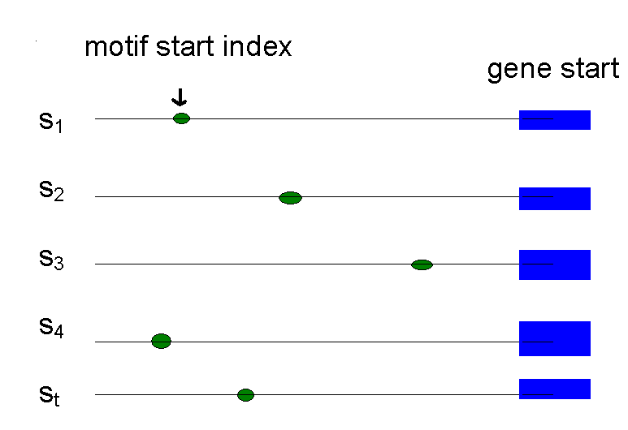
Defining Motifs
To define a motif, lets say we know where the motif starts in the sequence
The motif start positions in their sequences can be represented as s = (s₁,s₂,s₃,…,s_{t})

Slide 42
Motifs: Profiles and Consensus
  a G g t a c T t
  C c A t a c g t
  Alignment a c g t T A g t
  a c g t C c A t
  C c g t a c g G
  _________________
  A 3 0 1 0 3 1 1 0
  Profile C 2 4 0 0 1 4 0 0
  G 0 1 4 0 0 0 3 1
  T 0 0 0 5 1 0 1 4
  _________________
  Consensus A C G T A C G T
Line up the patterns by their start indexes
  s = (s₁, s₂, …, s_{t})
Construct matrix profile with frequencies of each nucleotide in columns
Consensus nucleotide in each position has the highest score in column

Slide 43
Consensus
Think of consensus as an “ancestor” motif, from which mutated motifs emerged
The distance between a real motif and the consensus sequence is generally less than that for two real motifs

Slide 44
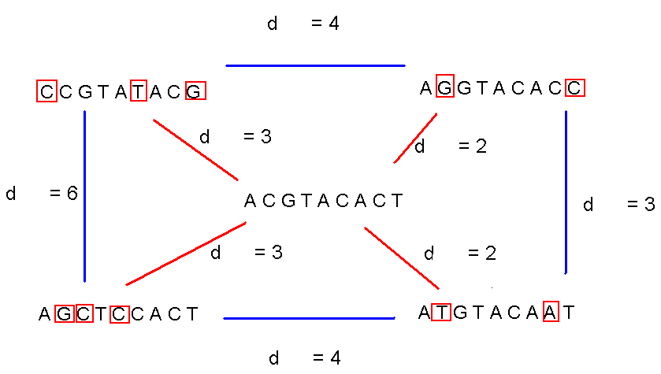
Consensus (cont’d)

Slide 45
Evaluating Motifs
We have a guess about the consensus sequence, but how “good” is this consensus?
Need to introduce a scoring function to compare different guesses and choose the “best” one.

Slide 46
Defining Some Terms
t - number of sample DNA sequences
n - length of each DNA sequence
DNA - sample of DNA sequences (t x n array)
l - length of the motif (l-mer)
s_{i} - starting position of an l-mer in sequence i
s=(s₁, s₂,… s_{t}) - array of motif’s starting positions

Slide 47
Parameters
  cctgatagacgctatctggctatccaGgtacTtaggtcctctgtgcgaatctatgcgtttccaaccat
  agtactggtgtacatttgatCcAtacgtacaccggcaacctgaaacaaacgctcagaaccagaagtgc
  aaacgtTAgtgcaccctctttcttcgtggctctggccaacgagggctgatgtataagacgaaaatttt
  agcctccgatgtaagtcatagctgtaactattacctgccacccctattacatcttacgtCcAtataca
  ctgttatacaacgcgtcatggcggggtatgcgttttggtcgtcgtacgctcgatcgttaCcgtacgGc
l = 8
DNA
t=5
n = 69
s
s₁ = 26 s₂ = 21 s₃= 3 s₄ = 56 s₅ = 60

Slide 48
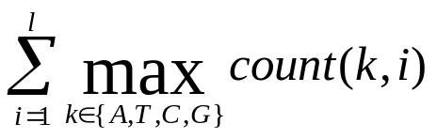
Scoring Motifs
l
Given s = (s₁, … s_{t}) and DNA:
Score(s,DNA) =
  a G g t a c T t
  C c A t a c g t
  a c g t T A g t
  a c g t C c A t
  C c g t a c g G
  _________________
  A 3 0 1 0 3 1 1 0
  C 2 4 0 0 1 4 0 0
  G 0 1 4 0 0 0 3 1
  T 0 0 0 5 1 0 1 4
  _________________
  Consensus a c g t a c g t
  Score 3+4+4+5+3+4+3+4=30
t

Slide 49
The Motif Finding Problem
If starting positions s=(s₁, s₂,… s_{t}) are given, finding consensus is easy even with mutations in the sequences because we can simply construct the profile to find the motif (consensus)
But… the starting positions s are usually not given. How can we find the “best” profile matrix?

Slide 50
The Motif Finding Problem: Formulation
Goal: Given a set of DNA sequences, find a set of l-mers, one from each sequence, that maximizes the consensus score
Input: A t x n matrix of DNA, and l, the length of the pattern to find
Output: An array of t starting positions
s = (s₁, s₂, … s_{t}) maximizing Score(s,DNA)

Slide 51
The Motif Finding Problem: Brute Force Solution
  Compute the scores for each possible combination of starting positions s
  The best score will determine the best profile and the consensus pattern in DNA
  The goal is to maximize Score(s,DNA) by varying the starting positions s_{i}, where:
  s_{i} = [1, …, n-l+1]
  i = [1, …, t]

Slide 52
BruteForceMotifSearch
BruteForceMotifSearch(DNA, t, n, l)
bestScore ← 0
for each s=(s₁,s₂ , . . ., s_{t}) from (1,1 . . . 1)
to (n-l+1, . . ., n-l+1)
if (Score(s,DNA) > bestScore)
bestScore ← score(s, DNA)
bestMotif ← (s₁,s₂ , . . . , s_{t})
return bestMotif

Slide 53
Running Time of BruteForceMotifSearch
Varying (n - l + 1) positions in each of t sequences, we’re looking at (n - l + 1)^{t} sets of starting positions
For each set of starting positions, the scoring function makes l operations, so complexity is
l (n – l + 1)^{t} = O(l n^{t})
That means that for t = 8, n = 1000, l = 10 we must perform approximately 10²⁰ computations – it will take billions years

Slide 54
The Median String Problem
Given a set of t DNA sequences find a pattern that appears in all t sequences with the minimum number of mutations
This pattern will be the motif

Slide 55
Hamming Distance
Hamming distance:
  d_{H}(v,w) is the number of nucleotide pairs that do not match when v and w are aligned. For example:
d_{H}(AAAAAA,ACAAAC) = 2

Slide 56
Total Distance: An Example
Given v = “acgtacgt” and s
acgtacgt
  cctgatagacgctatctggctatccacgtacgtaggtcctctgtgcgaatctatgcgtttccaaccat
  acgtacgt
  agtactggtgtacatttgatacgtacgtacaccggcaacctgaaacaaacgctcagaaccagaagtgc
  acgtacgt
  aaacgtacgtgcaccctctttcttcgtggctctggccaacgagggctgatgtataagacgaaaatttt
  acgtacgt
  agcctccgatgtaagtcatagctgtaactattacctgccacccctattacatcttacgtacgtataca
  acgtacgt
  ctgttatacaacgcgtcatggcggggtatgcgttttggtcgtcgtacgctcgatcgttaacgtacgtc
v is the sequence in red, x is the sequence in blue
TotalDistance(v,DNA) = 0
d_{H}(v, x) = 0
d_{H}(v, x) = 0
d_{H}(v, x) = 0
d_{H}(v, x) = 0
d_{H}(v, x) = 0

Slide 57
Total Distance: Example
Given v = “acgtacgt” and s
acgtacgt
  cctgatagacgctatctggctatccacgtacAtaggtcctctgtgcgaatctatgcgtttccaaccat
  acgtacgt
  agtactggtgtacatttgatacgtacgtacaccggcaacctgaaacaaacgctcagaaccagaagtgc
  acgtacgt
  aaaAgtCcgtgcaccctctttcttcgtggctctggccaacgagggctgatgtataagacgaaaatttt
  acgtacgt
  agcctccgatgtaagtcatagctgtaactattacctgccacccctattacatcttacgtacgtataca
  acgtacgt
  ctgttatacaacgcgtcatggcggggtatgcgttttggtcgtcgtacgctcgatcgttaacgtaGgtc
v is the sequence in red, x is the sequence in blue
TotalDistance(v,DNA) = 1+0+2+0+1 = 4
d_{H}(v, x) = 1
d_{H}(v, x) = 0
d_{H}(v, x) = 2
d_{H}(v, x) = 0
d_{H}(v, x) = 1

Slide 58
Total Distance: Definition
  For each DNA sequence i, compute all d_{H}(v, x), where x is an l-mer with starting position s_{i}
  (1 < s_{i} < n – l + 1)
  Find minimum of d_{H}(v, x) among all l-mers in sequence i
  TotalDistance(v,DNA) is the sum of the minimum Hamming distances for each DNA sequence i
  TotalDistance(v,DNA) = min_{s} d_{H}(v, s), where s is the set of starting positions s₁, s₂,… s_{t}

Slide 59
The Median String Problem: Formulation
Goal: Given a set of DNA sequences, find a median string
Input: A t x n matrix DNA, and l, the length of the pattern to find
Output: A string v of l nucleotides that minimizes TotalDistance(v,DNA) over all strings of that length

Slide 60
Median String Search Algorithm
MedianStringSearch (DNA, t, n, l)
bestWord ← AAA…A
bestDistance ← ∞
for each l-mer s from AAA…A to TTT…T if TotalDistance(s,DNA) < bestDistance
bestDistance←TotalDistance(s,DNA)
bestWord ← s
return bestWord

Slide 61
Motif Finding Problem == Median String Problem
The Motif Finding is a maximization problem while Median String is a minimization problem
However, the Motif Finding problem and Median String problem are computationally equivalent
Need to show that minimizing TotalDistance is equivalent to maximizing Score

Slide 62
We are looking for the same thing
l
  a G g t a c T t
  C c A t a c g t
  Alignment a c g t T A g t
  a c g t C c A t
  C c g t a c g G
  _________________
  A 3 0 1 0 3 1 1 0
  Profile C 2 4 0 0 1 4 0 0
  G 0 1 4 0 0 0 3 1
  T 0 0 0 5 1 0 1 4
  _________________
  Consensus a c g t a c g t
  Score 3+4+4+5+3+4+3+4
  TotalDistance 2+1+1+0+2+1+2+1
  Sum 5 5 5 5 5 5 5 5
At any column i
Score_{i} + TotalDistance_{i} = t
Because there are l columns
Score + TotalDistance = l * t
Rearranging:
Score = l * t - TotalDistance
l * t is constant the minimization of the right side is equivalent to the maximization of the left side
t

Slide 63
Motif Finding Problem vs.
Median String Problem
Why bother reformulating the Motif Finding problem into the Median String problem?
  The Motif Finding Problem needs to examine all the combinations for s. That is (n - l + 1)^{t} combinations!!!
  The Median String Problem needs to examine all 4^{l} combinations for v. This number is relatively smaller

Slide 64
Motif Finding: Improving the Running Time
Recall the BruteForceMotifSearch:
BruteForceMotifSearch(DNA, t, n, l)
bestScore ← 0
for each s=(s₁,s₂ , . . ., s_{t}) from (1,1 . . . 1) to (n-l+1, . . ., n-l+1)
if (Score(s,DNA) > bestScore)
bestScore ← Score(s, DNA)
bestMotif ← (s₁,s₂ , . . . , s_{t})
return bestMotif

Slide 65
Structuring the Search
How can we perform the line
for each s=(s₁,s₂ , . . ., s_{t}) from (1,1 . . . 1) to (n-l+1, . . ., n-l+1) ?
We need a method for efficiently structuring and navigating the many possible motifs
This is not very different than exploring all t-digit numbers

Slide 66
Median String: Improving the Running Time
MedianStringSearch (DNA, t, n, l)
bestWord ← AAA…A
bestDistance ← ∞
for each l-mer s from AAA…A to TTT…T if TotalDistance(s,DNA) < bestDistance
bestDistance←TotalDistance(s,DNA)
bestWord ← s
return bestWord

Slide 67
Structuring the Search
  For the Median String Problem we need to consider all 4^{l} possible l-mers:
aa… aa
aa… ac
aa… ag
aa… at
.
.
tt… tt
How to organize this search?
l

Slide 68
Alternative Representation of the Search Space
Let A = 1, C = 2, G = 3, T = 4
Then the sequences from AA…A to TT…T become:
11…11
11…12
11…13
11…14
.
.
44…44
Notice that the sequences above simply list all numbers as if we were counting on base 4 without using 0 as a digit
l

Slide 69
Linked List
Suppose l = 2
aa ac ag at ca cc cg ct ga gc gg gt ta tc tg tt
Need to visit all the predecessors of a sequence before visiting the sequence itself
Start

Slide 70
Linked List (cont’d)
Linked list is not the most efficient data structure for motif finding
Let’s try grouping the sequences by their prefixes
aa ac ag at ca cc cg ct ga gc gg gt ta tc tg tt

Slide 71
Search Tree
a- c- g- t-
aa ac ag at ca cc cg ct ga gc gg gt ta tc tg tt
root
--

Slide 72
Analyzing Search Trees
Characteristics of the search trees:
  The sequences are contained in its leaves
  The parent of a node is the prefix of its children
How can we move through the tree?

Slide 73
Moving through the Search Trees
Four common moves in a search tree that we are about to explore:
  Move to the next leaf
  Visit all the leaves
  Visit the next node
  Bypass the children of a node

Slide 74
Visit the Next Leaf
Given a current leaf a , we need to compute the “next” leaf:
NextLeaf( a,L, k ) // a : the array of digits
for i ← L to 1 // L: length of the array
if a_{i} < k // k : max digit value
a_{i} ← a_{i} + 1
return a
a_{i} ← 1
return a

Slide 75
NextLeaf (cont’d)
The algorithm is common addition in radix k:
Increment the least significant digit
“Carry the one” to the next digit position when the digit is at maximal value

Slide 76
NextLeaf: Example
Moving to the next leaf:
1- 2- 3- 4-
11 12 13 14 21 22 23 24 31 32 33 34 41 42 43 44
Current Location
--

Slide 77
NextLeaf: Example (cont’d)
Moving to the next leaf:
1- 2- 3- 4-
11 12 13 14 21 22 23 24 31 32 33 34 41 42 43 44
Next Location
--

Slide 78
Visit All Leaves
Printing all permutations in ascending order:
AllLeaves(L,k) // L: length of the sequence
a ← (1,...,1) // k : max digit value
while forever // a : array of digits
output a
a ← NextLeaf(a,L,k)
if a = (1,...,1)
return

Slide 79
Visit All Leaves: Example
Moving through all the leaves in order:
1- 2- 3- 4-
11 12 13 14 21 22 23 24 31 32 33 34 41 42 43 44
1 2 3 4 5 6 7 8 9 10 11 12 13 14 15
--
Order of steps

Slide 80
Depth First Search
So we can search leaves
How about searching all vertices of the tree?
We can do this with a depth first search

Slide 81
Visit the Next Vertex
  NextVertex(a,i,L,k) // a : the array of digits
  if i < L // i : prefix length
  a _{i+1} ← 1 // L: max length
  return ( a,i+1) // k : max digit value
  else
  for j ← l to 1
  if a_{j} < k
  a_{j} ← a_{j} +1
  return( a,j )
  return(a,0)

Slide 82
Example
Moving to the next vertex:
1- 2- 3- 4-
11 12 13 14 21 22 23 24 31 32 33 34 41 42 43 44
Current Location
--

Slide 83
Example
Moving to the next vertices:
1- 2- 3- 4-
11 12 13 14 21 22 23 24 31 32 33 34 41 42 43 44
Location after 5 next vertex moves
--

Slide 84
Bypass Move
Given a prefix (internal vertex), find next vertex after skipping all its children
Bypass(a,i,L,k) // a: array of digits
for j ← i to 1 // i : prefix length
if a_{j} < k // L: maximum length
a_{j} ← a_{j} +1 // k : max digit value
return(a,j)
return(a,0)

Slide 85
Bypass Move: Example
Bypassing the descendants of “2-”:
1- 2- 3- 4-
11 12 13 14 21 22 23 24 31 32 33 34 41 42 43 44
Current Location
--

Slide 86
Example
Bypassing the descendants of “2-”:
1- 2- 3- 4-
11 12 13 14 21 22 23 24 31 32 33 34 41 42 43 44
Next Location
--

Slide 87
Revisiting Brute Force Search
Now that we have method for navigating the tree, lets look again at BruteForceMotifSearch

Slide 88
Brute Force Search Again
BruteForceMotifSearchAgain(DNA, t, n, l)
s ← (1,1,…, 1)
bestScore ← Score(s,DNA)
while forever
s ← NextLeaf (s, t, n- l +1)
if (Score(s,DNA) > bestScore)
bestScore ← Score(s, DNA)
bestMotif ← (s₁,s₂ , . . . , s_{t})
return bestMotif

Slide 89
Can We Do Better?
Sets of s=(s₁, s₂, …,s_{t}) may have a weak profile for the first i positions (s₁, s₂, …,s_{i})
Every row of alignment may add at most l to Score
Optimism: if all subsequent (t-i) positions (s_{i+1}, …s_{t}) add
  (t – i ) * l to Score(s,i,DNA)
If Score(s,i,DNA) + (t – i ) * l < BestScore, it makes no sense to search in vertices of the current subtree
  Use ByPass()

Slide 90
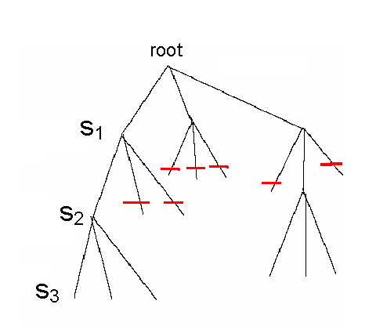
Branch and Bound Algorithm for Motif Search
Since each level of the tree goes deeper into search, discarding a prefix discards all following branches
This saves us from looking at (n – l + 1)^{t-i} leaves
  Use NextVertex() and ByPass() to navigate the tree

Slide 91
Pseudocode for Branch and Bound Motif Search
BranchAndBoundMotifSearch(DNA,t,n,l)
s ← (1,…,1)
bestScore ← 0
i ← 1
while i > 0
if i < t
optimisticScore ← Score(s, i, DNA) +(t – i ) * l
if optimisticScore < bestScore
(s, i) ← Bypass(s,i, n-l +1)
else
(s, i) ← NextVertex(s, i, n-l +1)
else
if Score(s,DNA) > bestScore
bestScore ← Score(s)
bestMotif ← (s₁, s₂, s₃, …, s_{t})
(s,i) ← NextVertex(s,i,t,n-l + 1)
return bestMotif

Slide 92
Median String Search Improvements
Recall the computational differences between motif search and median string search
  The Motif Finding Problem needs to examine all (n-l +1)^{t} combinations for s.
  The Median String Problem needs to examine 4^{l} combinations of v. This number is relatively small
We want to use median string algorithm with the Branch and Bound trick!

Slide 93
Branch and Bound Applied to Median String Search
Note that if the total distance for a prefix is greater than that for the best word so far:
  TotalDistance (prefix, DNA) > BestDistance
there is no use exploring the remaining part of the word
We can eliminate that branch and BYPASS exploring that branch further

Slide 94
Bounded Median String Search
BranchAndBoundMedianStringSearch(DNA,t,n,l )
s ← (1,…,1)
bestDistance ← ∞
i ← 1
while i > 0
if i < l
prefix ← string corresponding to the first i nucleotides of s
optimisticDistance ← TotalDistance(prefix,DNA)
if optimisticDistance > bestDistance
(s, i ) ← Bypass(s,i, l, 4)
else
(s, i ) ← NextVertex(s, i, l, 4)
else
word ← nucleotide string corresponding to s
if TotalDistance(s,DNA) < bestDistance
bestDistance ← TotalDistance(word, DNA)
bestWord ← word
(s,i ) ← NextVertex(s,i,l, 4)
return bestWord

Slide 95
Improving the Bounds
Given an l-mer w, divided into two parts at point i
  u : prefix w₁, …, w_{i},
  v : suffix w_{i+1}, ..., w_{l}
Find minimum distance for u in a sequence
No instances of u in the sequence have distance less than the minimum distance
Note this doesn’t tell us anything about whether u is part of any motif. We only get a minimum distance for prefix u

Slide 96
Improving the Bounds (cont’d)
Repeating the process for the suffix v gives us a minimum distance for v
Since u and v are two substrings of w, and included in motif w, we can assume that the minimum distance of u plus minimum distance of v can only be less than the minimum distance for w

Slide 97
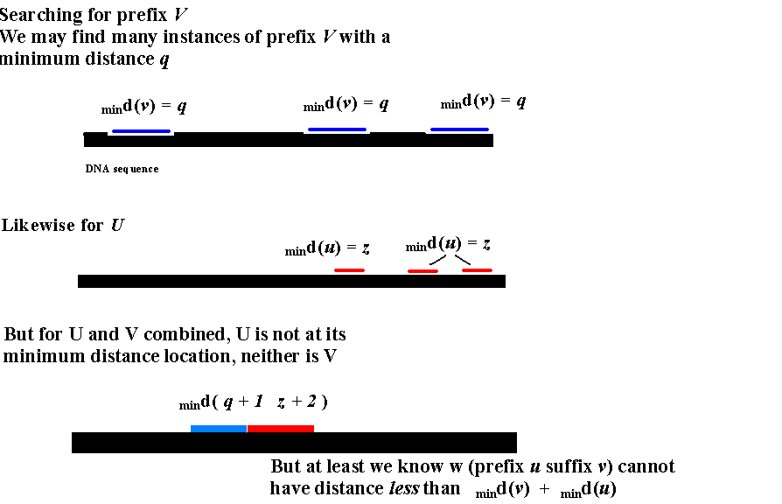
Better Bounds

Slide 98
Better Bounds (cont’d)
If d(prefix) + d(suffix) > bestDistance:
  Motif w (prefix.suffix) cannot give a better (lower) score than d(prefix) + d(suffix)
  In this case, we can ByPass()

Slide 99
Better Bounded Median String Search
ImprovedBranchAndBoundMedianString(DNA,t,n,l)
s = (1, 1, …, 1)
bestdistance = ∞
i = 1
while i > 0
if i < l
prefix = nucleotide string corresponding to (s₁, s₂, s₃, …, s_{i} )
optimisticPrefixDistance = TotalDistance (prefix, DNA)
if (optimisticPrefixDistance < bestsubstring[ i ])
bestsubstring[ i ] = optimisticPrefixDistance
if (l - i < i )
optimisticSufxDistance = bestsubstring[l -i ]
else
optimisticSufxDistance = 0;
if optimisticPrefixDistance + optimisticSufxDistance > bestDistance
(s, i ) = Bypass(s, i, l, 4)
else
(s, i ) = NextVertex(s, i, l,4)
else
word = nucleotide string corresponding to (s₁,s₂, s₃, …, s_{t})
if TotalDistance( word, DNA) < bestDistance
bestDistance = TotalDistance(word, DNA)
bestWord = word
(s,i) = NextVertex(s, i,l, 4)
return bestWord

Slide 100
More on the Motif Problem
Exhaustive Search and Median String are both exact algorithms
They always find the optimal solution, though they may be too slow to perform practical tasks
Many algorithms sacrifice optimal solution for speed

Slide 101
CONSENSUS: Greedy Motif Search
Find two closest l-mers in sequences 1 and 2 and forms
2 x l alignment matrix with Score(s,2,DNA)
At each of the following t-2 iterations CONSENSUS finds a “best” l-mer in sequence i from the perspective of the already constructed (i-1) x l alignment matrix for the first (i-1) sequences
In other words, it finds an l-mer in sequence i maximizing
Score(s,i,DNA)
under the assumption that the first (i-1) l-mers have been already chosen
CONSENSUS sacrifices optimal solution for speed: in fact the bulk of the time is actually spent locating the first 2 l-mers

Slide 102
Some Motif Finding Programs
CONSENSUS
Hertz, Stromo (1989)
GibbsDNA
Lawrence et al (1993)
MEME
Bailey, Elkan (1995)
RandomProjections
Buhler, Tompa (2002)
MULTIPROFILER Keich, Pevzner (2002)
MITRA
Eskin, Pevzner (2002)
Pattern Branching
Price, Pevzner (2003)

Slide 103
Planted Motif Challenge
Input:
  n sequences of length m each.
Output:
  Motif M, of length l
  Variants of interest have a hamming distance of d from M

Slide 104
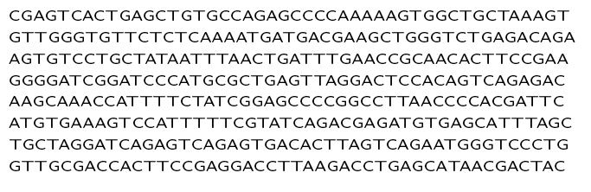
How to proceed?
Exhaustive search?
Run time is high

Slide 105
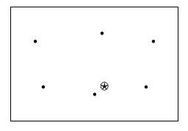
How to search motif space?
Start from random sample strings
Search motif space for the star

Slide 106
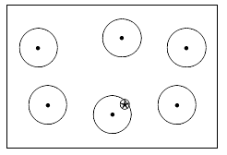
Search small neighborhoods

Slide 107
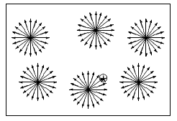
Exhaustive local search
A lot of work, most of it unecessary

Slide 108
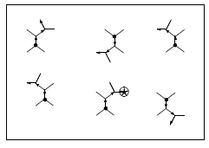
Best Neighbor
Branch from the seed strings
Find best neighbor - highest score
Don’t consider branches where the upper bound is not as good as best score so far

Slide 109
Scoring
PatternBranching use total distance score:
For each sequence S_{i} in the sample S = {S₁, . . . , S_{n}}, let
d(A, S_{i}) = min{d(A, P) | P ∈ S_{i}}.
Then the total distance of A from the sample is
d(A, S) = ∑ Si ∈ S d(A, S_{i}).
For a pattern A, let D=Neighbor(A) be the set of patterns which differ from A in exactly 1 position.
We define BestNeighbor(A) as the pattern B ∈ D=Neighbor(A) with lowest total distance d(B, S).

Slide 110
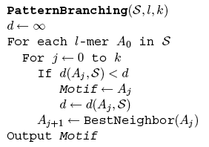
PatternBranching Algorithm

Slide 111
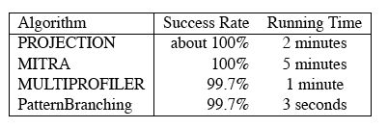
PatternBranching Performance
PatternBranching is faster than other pattern-based algorithms
Motif Challenge Problem:
  sample of n = 20 sequences
  N = 600 nucleotides long
  implanted pattern of length l = 15
  k = 4 mutations

Slide 112
PMS (Planted Motif Search)
Generate all possible l-mers from out of the input sequence S_{i}. Let C_{i} be the collection of these l-mers.
Example:
  AAGTCAGGAGT
  C_{i} = 3-mers:
  AAG AGT GTC TCA CAG AGG GGA GAG AGT

Slide 113
All patterns at Hamming distance d = 1
AAG AGT GTC TCA CAG AGG GGA GAG AGT
CAG CGT ATC ACA AAG CGG AGA AAG CGT
GAG GGT CTC CCA GAG TGG CGA CAG GGT
TAG TGT TTC GCA TAG GGG TGA TAG TGT
ACG ACT GAC TAA CCG ACG GAA GCG ACT
AGG ATT GCC TGA CGG ATG GCA GGG ATT
ATG AAT GGC TTA CTG AAG GTA GTG AAT
AAC AGA GTA TCC CAA AGA GGC GAA AGA
AAA AGC GTG TCG CAC AGT GGG GAC AGC
AAT AGG GTT TCT CAT AGC GGT GAT AGG

Slide 114
Sort the lists
AAG AGT GTC TCA CAG AGG GGA GAG AGT
AAA AAT ATC ACA AAG AAG AGA AAG AAT
AAC ACT CTC CCA CAA ACG CGA CAG ACT
AAT AGA GAC GCA CAC AGA GAA GAA AGA
ACG AGC GCC TAA CAT AGC GCA GAC AGC
AGG AGG GGC TCC CCG AGT GGC GAT AGG
ATG ATT GTA TCG CGG ATG GGG GCG ATT
CAG CGT GTG TCT CTG CGG GGT GGG CGT
GAG GGT GTT TGA GAG GGG GTA GTG GGT
TAG TGT TTC TTA TAG TGG TGA TAG TGT

Slide 115
Eliminate duplicates
AAG AGT GTC TCA CAG AGG GGA GAG AGT
AAA AAT ATC ACA AAG AAG AGA AAG AAT
AAC ACT CTC CCA CAA ACG CGA CAG ACT
AAT AGA GAC GCA CAC AGA GAA GAA AGA
ACG AGC GCC TAA CAT AGC GCA GAC AGC
AGG AGG GGC TCC CCG AGT GGC GAT AGG
ATG ATT GTA TCG CGG ATG GGG GCG ATT
CAG CGT GTG TCT CTG CGG GGT GGG CGT
GAG GGT GTT TGA GAG GGG GTA GTG GGT
TAG TGT TTC TTA TAG TGG TGA TAG TGT

Slide 116
Find motif common to all lists
Follow this procedure for all sequences
Find the motif common all L_{i} (once duplicates have been eliminated)
This is the planted motif

Slide 117


PMS Running Time
It takes time to
  Generate variants
  Sort lists
  Find and eliminate duplicates
Running time of this algorithm:
w is the word length of the computer

